Slide 1


Learning to Read
Year 1 Phonics

Slide 2


Notes:
Just to start I wanted to say a huge thank you for giving your time to be here today.
Research shows that children who learn to read early go on to succeed both in school and in life.
At Burnham Infants, we are incredibly passionate about this which is why reading and phonics holds such a priority for us.

Slide 3
Our aims for the workshop are:
    To develop your understanding of phonics
    To develop your understanding of what reading is
    To encourage a love of reading by working together
Notes:
We are going to do this by looking at :
Phonics
Reading
Phonics Screening
Concerns about progress
Explain how you are structuring the session/ sessions to give them information about how early reading is taught at your school and how they can play a vital role in supporting their child’s reading journey.

Slide 4


Reading for pleasure
Finding out information
Understanding forms and official documents
Reading the world around
Accessing learning
Notes:
Reading is one of the most important things we can teach our children. We want all our children to be avid readers with a love for all different types of literature.
Think of reading activities you do everyday….
reading for pleasure - subtitles, social media, books
reading the world around them - Road signs, shops/logos,
As children start their school life they will very much focus on learning to read. As they move on and beyond they will be reading to learn.
So it is vitally important that we support our pupils to quickly learn to read. We want every child to love reading and to do this we must make sure that it is a pleasurable experience and that they can read with accuracy and fluency so they can access as many opportunities as possible.

Slide 5

Research
Link between the words we say and the letters that represent each sound.
Grapheme
Phoneme
Notes:
Thanks to research we know that phonics is the best way to teach children to read, and the national curriculum says that phonics should be the main way that school should teach children to read.
All children in the school use Unlocking Letters and Sounds to teach their phonics and early reading, as a school , we think this is the best one for our children.
All staff have had training with this scheme so they are all experts at using it.
Phonics teaches the link between the words we read/ say and the words we write on the page. It teaches how the letters in written words represent the sounds we say in spoken words – this is called decoding.
In the word ph –o –n – i –c -s
When we say this word we say lots of sounds very quickly – so quickly we hardly notice the sound each letter makes.
This is phonics!
There is some technical vocabulary that we use for phonics and that your children will use.
Grapheme – the written letter or groups of letters
Phoneme – the sounds that the grapheme makes.
You will find a handout.

Slide 6
The Alphabetic Code
44 phonemes
Simple Code
Complex Code
Notes:
The English language is made up of about 44 different sounds in different combinations – it is one of the most complicated languages.
It will take most children about three years to learn the alphabetic code and to use it to read.
We know that children won’t learn to read by themselves so we will be teaching phonics every day to help them learn.
Your children will have a daily phonics lesson from Reception until Year 2.
They will be taught by their teacher in the whole class and each lesson will last between 25 and 30 minutes.
When we start this decoding journey we will keep things very simple. We will teach basic phonemes and their matching graphemes (such as cat and map). This means that children rapidly learn and understand and to build confidence in their reading. This teaching will start straight away in Reception.
We’ve looked at examples where a phoneme is represented by a single letters.
Some sounds are represented by graphemes that have two or more letters. (Digraphs)
Eg. Sh o p th i n r i ch
The sounds sh, th and ch are represented by two letters – these are called digraphs.
Some sounds are represented by three letters:
Eg. L igh t
The sound igh is represented by 3 letters - this is called a trigraph.
Your child will be coming home telling you all about phonemes, graphemes, digraphs and trigraphs! They will be fantastic at understanding this vocabulary as they are learning the alphabetic code and you can help by using these words at home.
As you children continue to learn to read they alphabetic code will become more complex. They will learn about sounds that are represented by lots of different graphemes and how some graphemes can represent different sounds. The complexity of the English alphabetic code is why it takes so long to read. Many children will find different parts challenging – especially at first. But our staff ae skilled at teaching phonics and will be gradually working through the alphabetic code so that every child become an expert reader.

Slide 7
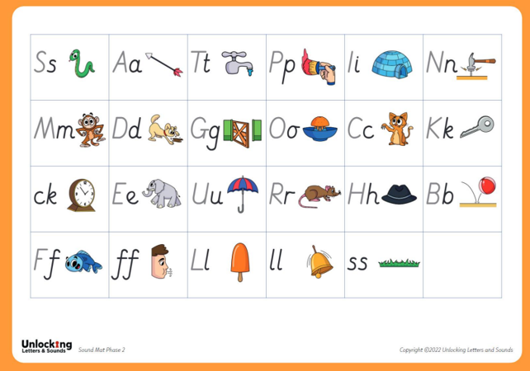
Phase 2
Notes:
As children start to learn their grapheme phoneme correspondences (GPCs) it is very important that we pronounce the sounds clearly and purely. We must be very careful not to add it on when enunciating a phoneme.
m=mm and not muh
S=ss and not suh
And the phonemes ‘clipped’ so they are not elongated – keeping them short and snappy.
m=mm and not mmmmmmmmmm
s=ss and not sssssssssssssssssss

Slide 8
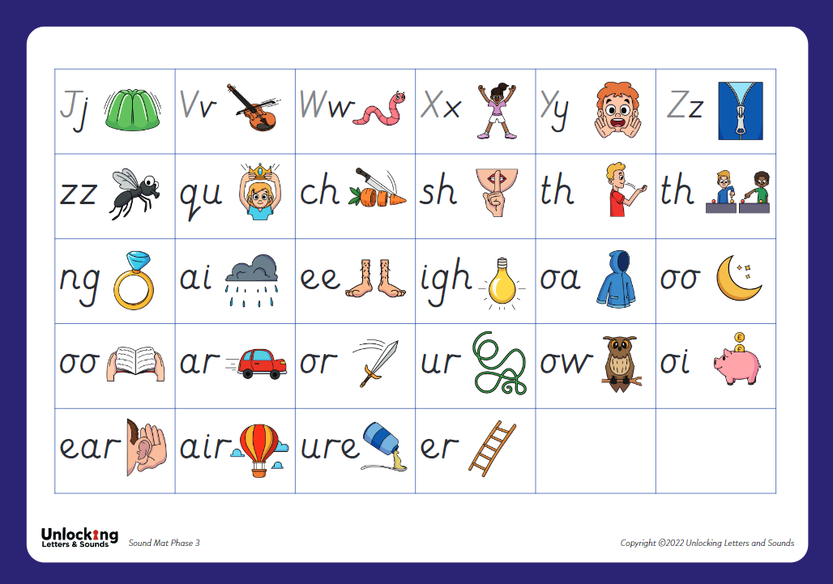
Phase 3
Notes:
Learn another 25 graphemes mostly digraphs – they will have 42 phonemes at the end of phase 3

Slide 9




Phase 4
Notes:
Consolidate phoneme and grapheme knowledge – for reading and spelling
Words containing adjacent consonants and polysyllabic words

Slide 10
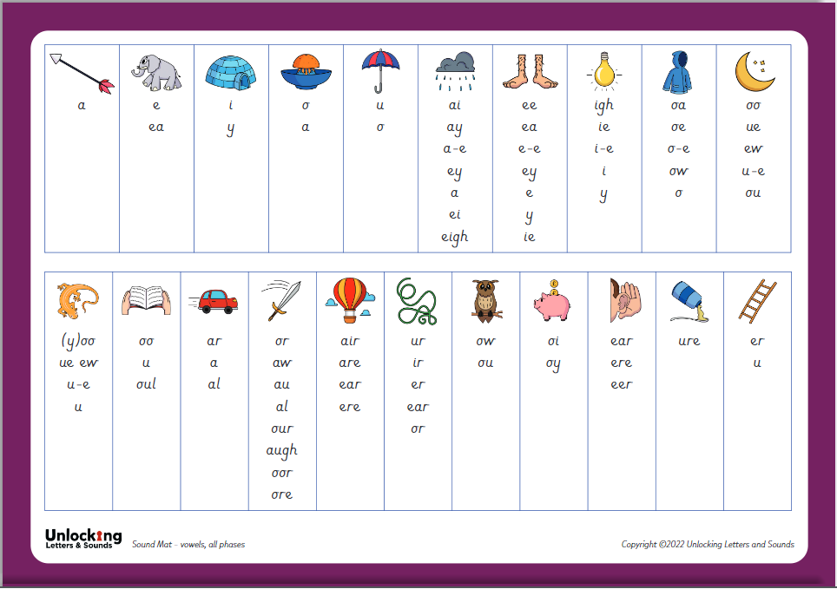
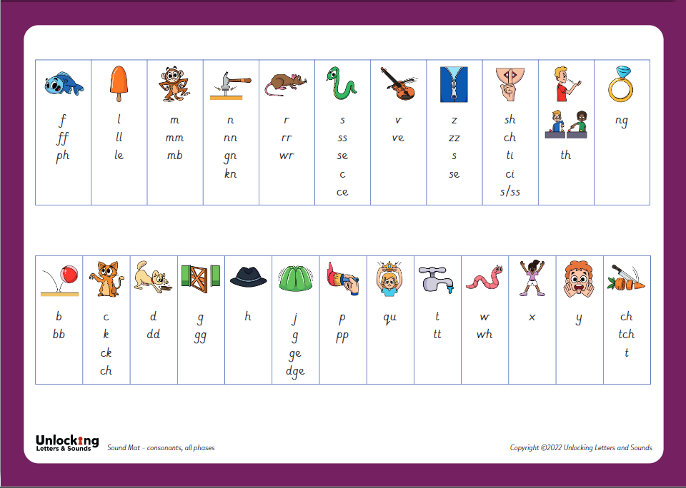
Phase 5
Notes:
In year 1
Phase 5a – teach new graphemes for reading for example ‘aw’ making the or phoneme
Straw (or) Sea (ee) Few (oo) Snake (ai)
5b – teach alternative pronunciations of known graphemes for reading ‘ie’ making the ‘ee’ phoneme
Mind chief gym
5c – teach alternative spellings of phonemes ‘mb’ representing the m phoneme
Fudge lamb caught
By the end of year 1 they would have been taught all of these graphemes for their known phonemes.
So for ‘ai’ – there are 7 different graphemes for the children to learn and use.

Slide 11
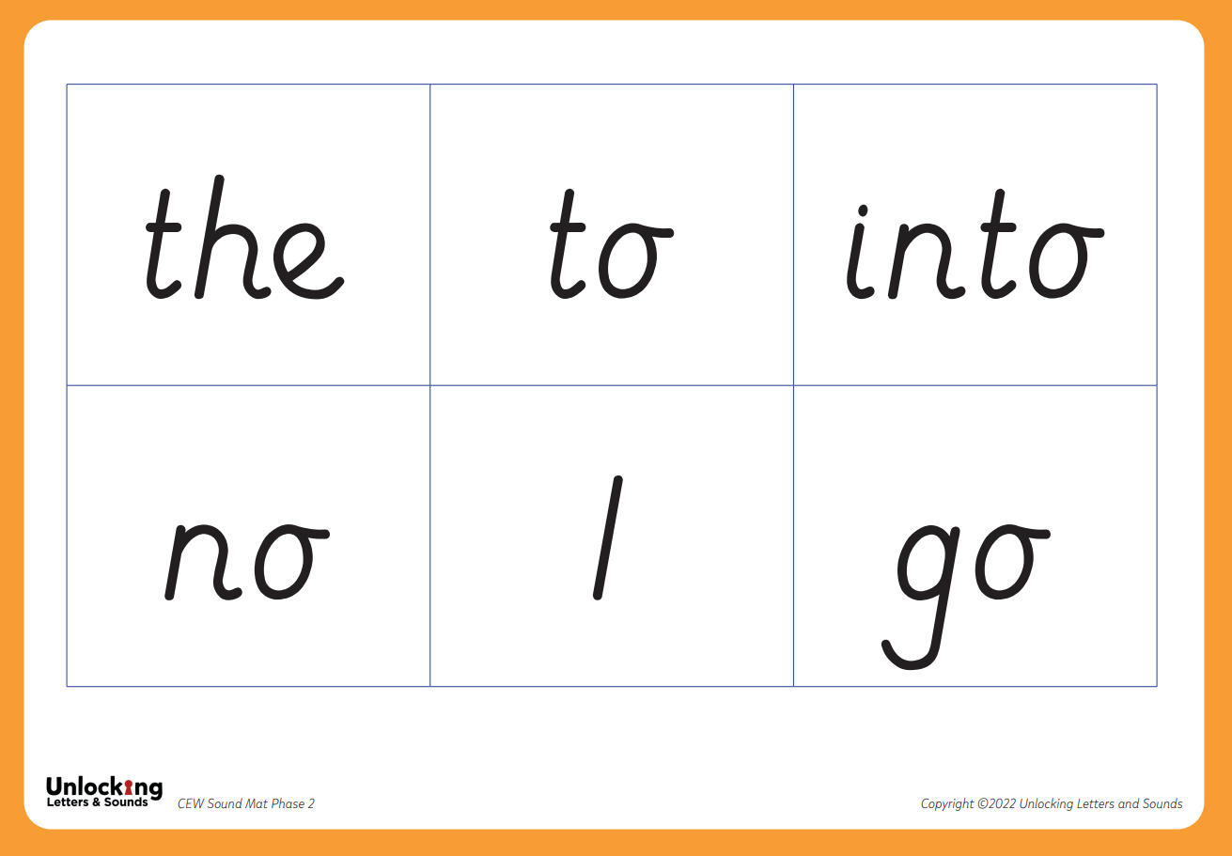
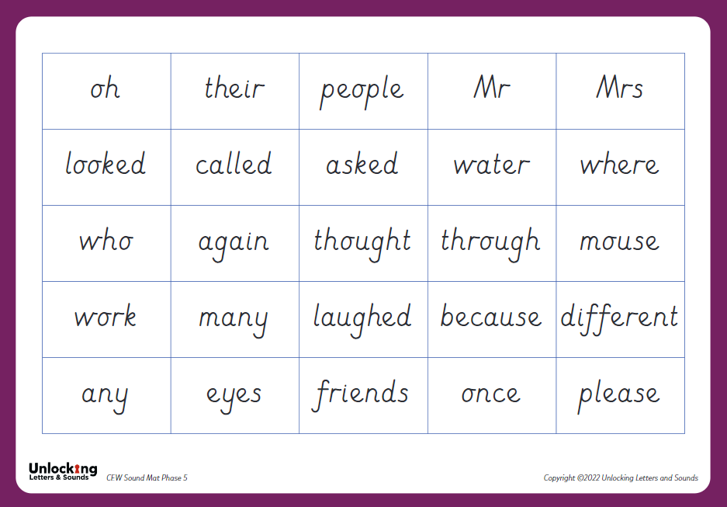
Blending
Common exception words
Spelling
Notes:
BLENDING. is a really important skills that children need lots of practice at – it will take lots of time!
Let’s have a go at blending a word: t / r / ee
We want to teach children to recognise the grapheme quickly so they can blend it rapidly. Once they can do this their reading will become fluent – and less painful! But this really does take a huge amount of practise so it is really important that children practise this at home with the books we give them.
As children progress in their reading journey they will begin to read longer words made up of multiple syllables – give the example of fun – funny – funniest
We teach these words by ‘chunking’ them into syllables and blending these chunks together. But we are still identifying the GPCs and blending them together.
This is what we will do as adults when we come across an unfamiliar word – use the example crepuscular. How would we read this unfamiliar word? We would chunk it and blend the syllables together. This is why it’s really important to teach children to read using phonics – without this skills to decode the graphemes we would not be able to read unfamiliar words.
There are some words that we use a lot in English such as the, like, said, were.
To give children’s reading a boost and so they can access more tests quickly we want children to learn these CEWs early on. Many of them have usual patterns or GPCs that aren’t taught until later on. So we teach children to recognise them by sight initially. Children will be able to decode some of them later on but, until they have learnt to decode them, we recognise them as CEWs.
They are not tricky words they have tricky parts
Can you find the tricky part
Tricky words will become decodable when you learn further GPC’s
In school the children will take part in
- Daily phonics lesson (30minutes)
Incidental practice – this is ongoing practice throughout the day
such as children being flash carded when lining up
Passcodes – hand prints on doorways
Half termly and ongoing assessments – informing interventions, as well as which phonically decodable book
Interventions – for those children with gaps in knowledge
We teach children to use their phonics to spell in the opposite way. Instead of blending the phonemes together to spell a words we seperate the phonemes so we can hear each sound to be able to spell the word. This is called segmenting.
Let’s try segmenting this word to write it: sh i p
Your child will write words, captions and sentences as part of their phonics lesson each day. As with reading, we will only ask them to write words contacting GPCs they have been taught. As part of their daily lesson we will also teach them how to write and form the letters they are writing.

Slide 12



Read, read, read!
Stick GPCs around the house
Child’s decodable book
Being read to
ea
Sharing stories to develop vocabulary e.g. saucer, sequins, bowl
air
Notes:
Help at home
Phonics works best when children are given plenty of encouragement and learn to enjoy reading and books.
Parents play a very important part in helping with this.
• With all books, encourage your child to ‘sound out’ unfamiliar words and then blend the sounds together from left to right rather than looking at the pictures to guess.
Once your child has read an unfamiliar word you can talk about what it means and help him or her to follow the story.
• Try to make time to read with your child every day. Grandparents and older brothers or sisters can help, too.
The more they read, the faster progress they will make.
Please avoid saying, ‘This book is too easy for you! But instead say ‘I love how well you can read this book!’
Story time - read to your child
ask lots of questions and share opinions
TALK to your child as much as possible and
‘feed’ them new and ambitious vocabulary.
“Let’s eat our lunch now.”
“Let’s munch our lunch now.”
“Let’s devour our lunch now!”
You’re looking ... not just... but...
Vocabulary Enrich conversations through description:
“Look at that rain. It looks like little diamonds sparkling
on the window pane!”
Have fun with words and language.
“I’m as hot as a spud in a cooking pot!”
Praise your child for using new words or
interesting phrases

Slide 13

Reading and Books
Books precisely match children’s phonics attainment
5 – 10 minutes
Choose a time that works for you
Be positive and celebrate successes
Encourage them to point to the graphemes
Encourage them to say the sounds and blend them together
Be patient and let them try and work it out
Read common exception words by sight.
Notes:
Once your child can read they will be given a book that precisely matches their phonics attainment so that they can read at least 95% of the words in it. Please don’t think that this makes the book too easy for them – it’s vitally important that reading is a celebration of children’s reading with you and a chance for them to show their phonics expertise.
In school we will also be reading with children. They will read everyday in their phonics lessons and also every week in a guided group. This is when they read with their teacher in a small group. The teacher will listen to every child read as well as teaching for part of the session. This allows us to check every child’s learning.
When teachers assess they are ready to move onto the next set we wil do so but we know that this takes a different amount of time for each child – some will need more practice than others.
Reading at home is essential as it gives children the opportunity to practice their decoding and blending skills.
We know everyone is busy and children often don’t want to read out of schools. Our top tips are:
5 – 10 minutes every day is often more effective than longer times
Find a time that works for you. Reading at bed time sounds lovely but with a tired child it can often be tricky!
Celebrate what your child can do and
Encourage your child to point at the graphemes as they read – this helps them to track the words and know their place
Encourage them t o say all the sounds in the words and then blend them together – you can show them how to do this.
Be patient and give them time to work it out before stepping in before stepping in If they can’t read a word model how to do it and then ask them to do it.
Let them read common exception words by sight.
One of the most important ways to increase children’s accuracy, fluency and understanding of the book they are reading is to re-read the same books several times. This is why we only give XX number of books each week – we would like each book to be read at least three times with a different focus each time.
This films explains the value of re- reading the same book and what you should focus on each time. https://www.youtube.com/watch?v=Hhu3xeNq3Kg&t=200s
When reading with your child at home, it is meant to be easy! They are consolidating what they have learnt at school, not learning anything new. If they find it too difficult they will not enjoy
reading at home. Reading is a pleasurable activity.

Slide 14

Sharing Books
Continue to read to your child.
Model how to read a book – left to right, turning pages
Ask questions about what has happened and characters’ feelings
Support vocabulary
Predict what will happen next
Make connections
Model your love of reading!
Notes:
Whilst learning to decode and reading books that allow children to do this is important there is so much more to reading! We know that decodable books are not the most exciting to read and alone, won’t give our early readers all the skills they need to develop a love of reading.
It is therefore important that you continue to read to your child and share a wide range of books with them – these should be books that children cannot decode themselves. Reading books to children is a precious and lovely thing to do – we are sure you and your child already have favourite books that you share together! By modelling reading and show how much you love reading you will be setting a fantastic example to your child.
When you read to your child you will want to:
Model how to read a book
Ask questions about what has happened to support your child’s comprehension or understanding of the text
Ask questions about characters’ feelings
Discuss the meaning of words and vocabulary
Ask children to predict what they think will happen next
Make connections with things your child has experienced or other books or films they have seen
• Try to build this into your daily routine
Let your children see you read
Boys need to see that reading is something men do
• Have a set space you can read in
• Remember, both reading the school book and reading to your child are important.
Make your own books
Make it fun!
Talk about books.
Sit and listen - don’t do chores around the reader!
Respect choices.
Most importantly – show that you love reading! By modelling this you will support your child to develop their love of reading.

Slide 15
Concerns about progress
All children are different
Discuss any concerns with teachers
Teachers will assess your child regularly
Interventions to support child in the specific skill they are struggling with
Adaptions for children with SEND
Notes:
All children are different and, at different points in their learning, will find things more difficult or challenging. Staff at our school have all had training to identify what children are finding difficult and to help them overcome this. We know if is very tempting to compare you child to others – especially with reading and what books they are on etc but we would suggest you speak to teachers if you have any concerns. If we have any concerns we will discuss them with you – and we might ask you to do some extra practice at home.
Teachers and TAs will assess your child reguarly to check their learning. We quickly identify any child who might be at risk of falling behind and will support them with extra phonics- usually by giving them ‘interventions’ to support the specific skill they are struggling with – some children may struggle to identify the GPC, others might not be able to blend yet.
If a child has SEND we ma need to make adaptions to their phonics eg. additional time to practice, more visuals . Again we will discuss these with you but research has shown that phonics is the most effective way of teaching children with SEND to read.

Slide 16
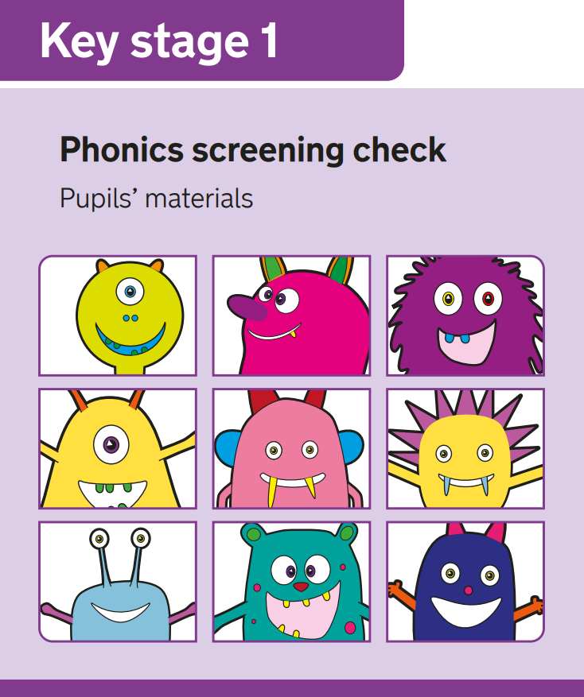
Phonics Screening Check
What is it?
40 words
Real and pseudo (alien)
Allows teachers to assess progress
Results and feedback
Pass mark
Scores will be shared with parents
Re-test in Year 2 if needed
Notes:
Phonics screening check happens each year during the same week of June. Any children in year 2 who did not pass the screening will also take the check.
The check is designed to confirm whether children have learnt sufficient decoding and blending skills to an appropriate standard.
The check contains 40 words – 20 real and 20 pseudo (alien) words
You will receive a letter at the end of the Summer term informing you whether or not your child has passed the phonics screening.

Slide 17
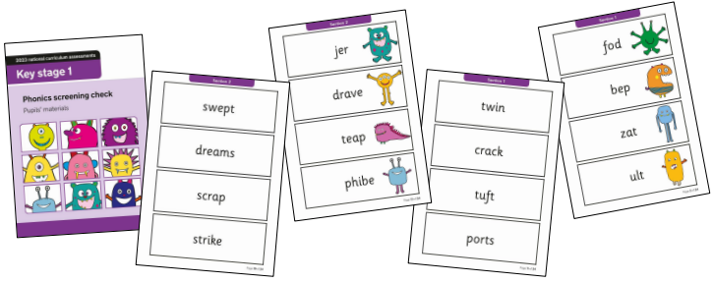
Notes:
The pseudo words are included because they will be new to all pupils; they do not favour children with a good vocabulary or visiual memory of words. They are decodable by applying their phonics skills. The children will need to read these with the correct sounds to show that they understand the phonic rules and an ability to decode newly encountered words.
The pseudo will be shown with a picture of an alien.
Spot the digraphs
Adjacent consonants
Spot the digraphs- phase 3 and phase 5
Adjacent consonants
Polysyllabic words

Slide 18


Adding sound buttons
Notes:
Since 2013 pass threshold has been 32/40 – you will be informed at the end of summer term.

Slide 19

Notes:
Thank you!
Happy Reading!
I will be staying for next …. Mins please feel free to ask any questions or you can catch me, your class teacher at end of the day.
POWERPINT and READING LETTER on school website

