Slide 1
Phonics workshop
Unlocking Letters and Sounds
Phonics screening check
March 2024
How you can help at home
Questions and answers

Slide 2
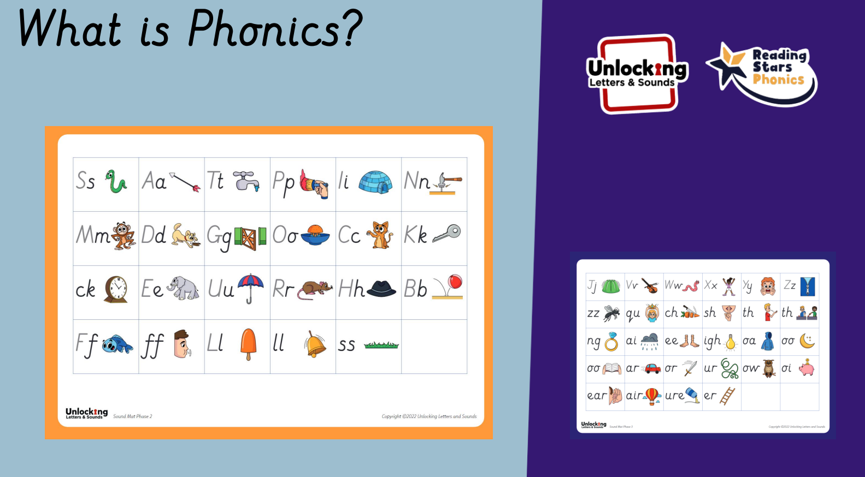

Slide 3
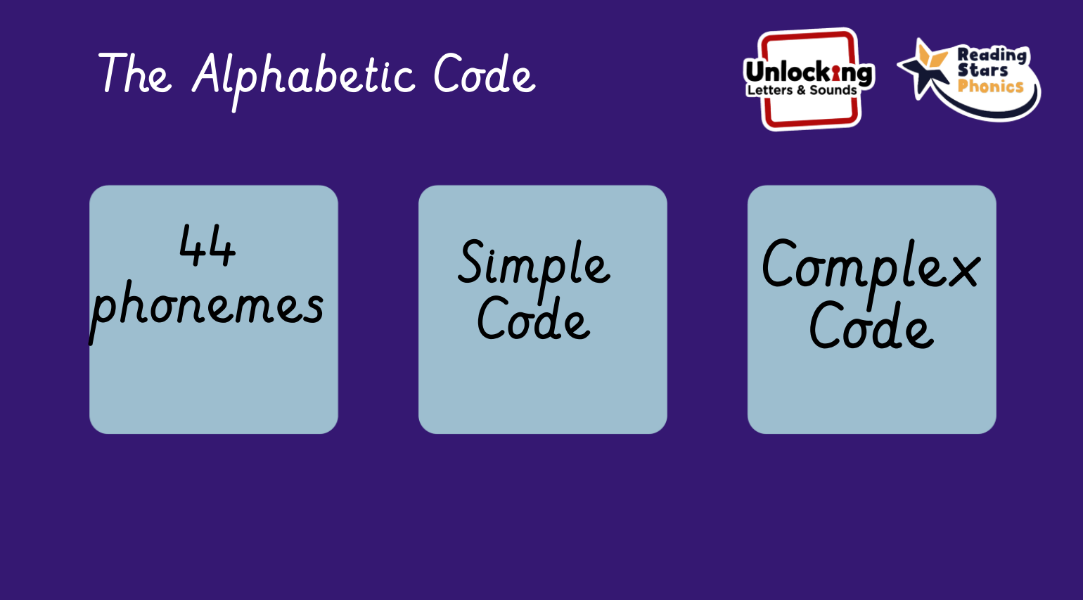

Slide 4
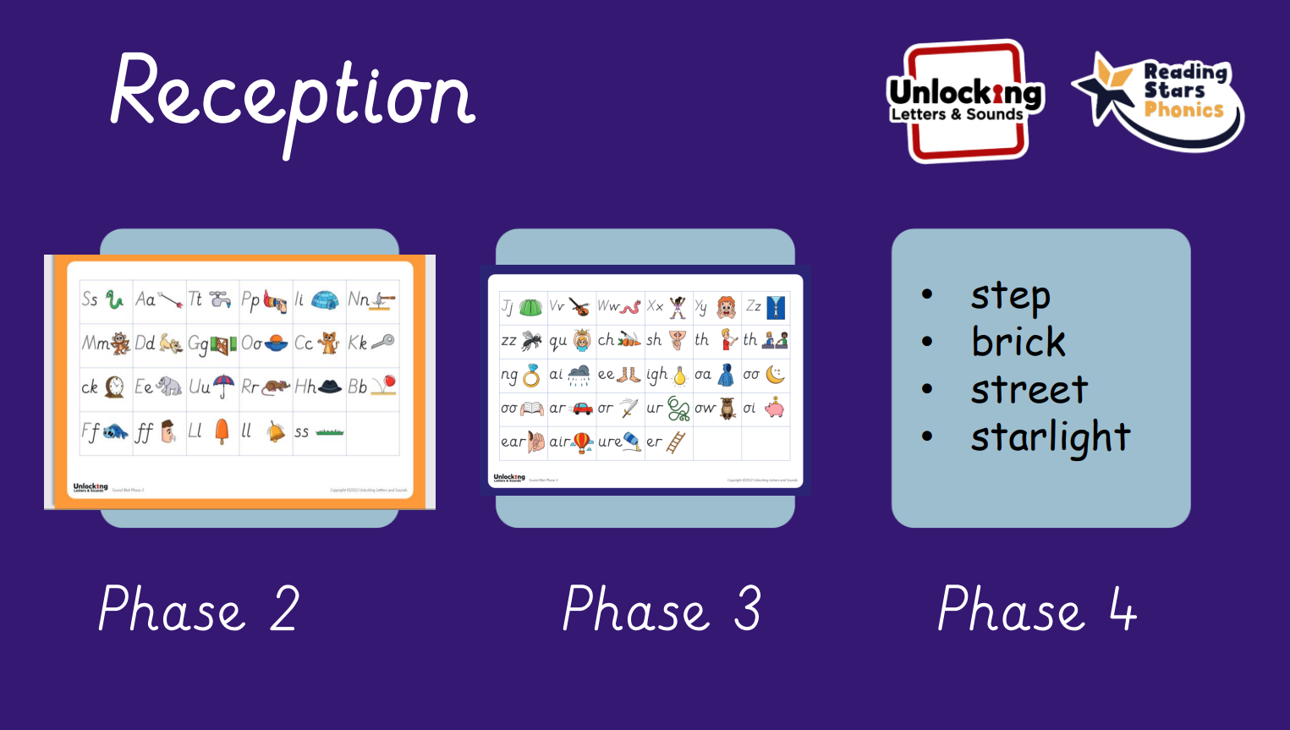

Slide 5
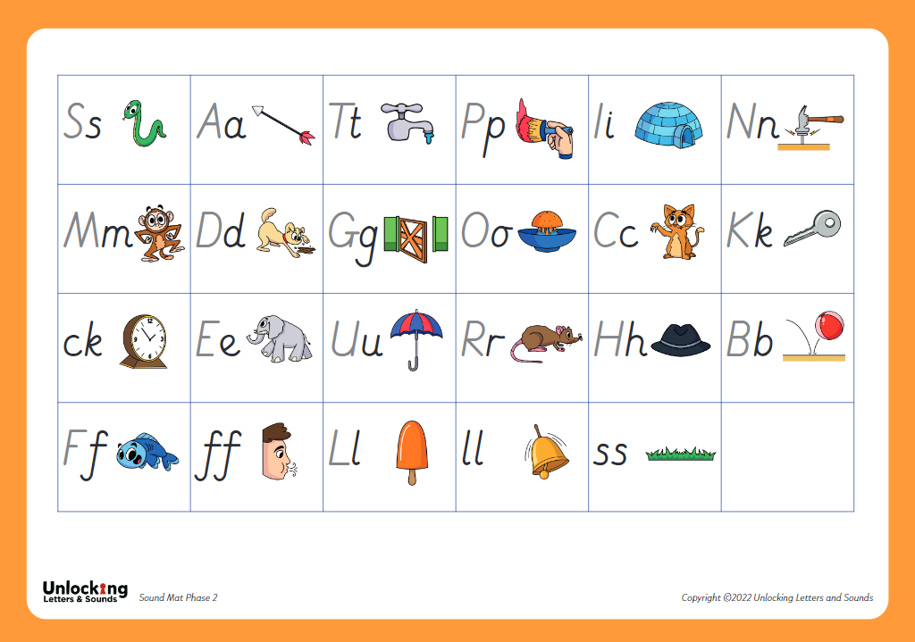
Phase 2

Slide 6
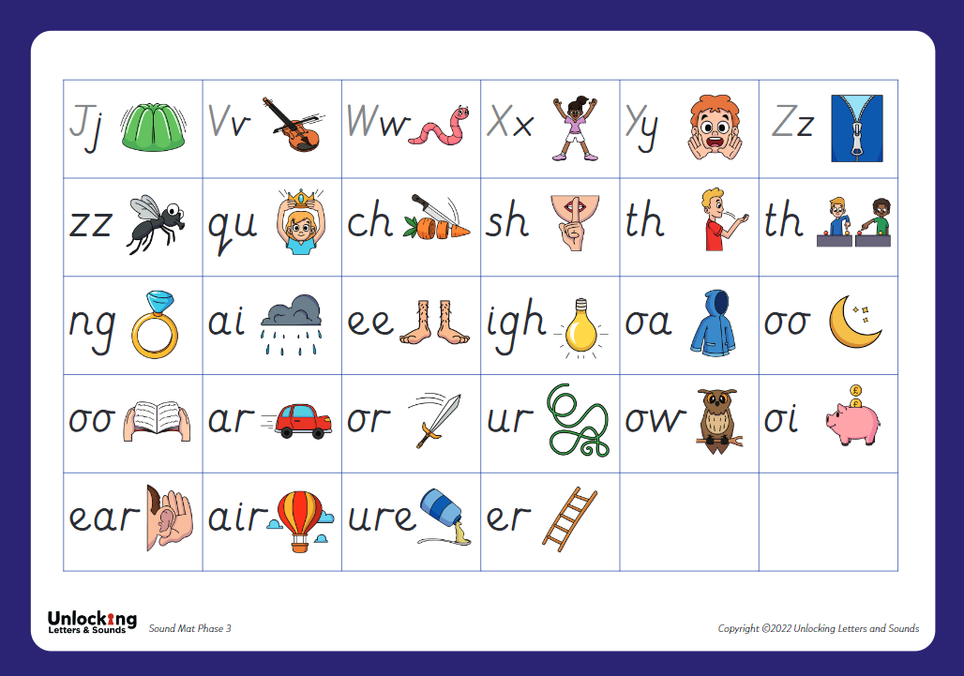
Phase 3

Slide 7


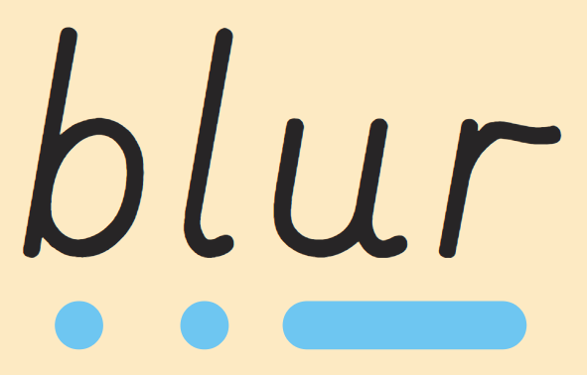
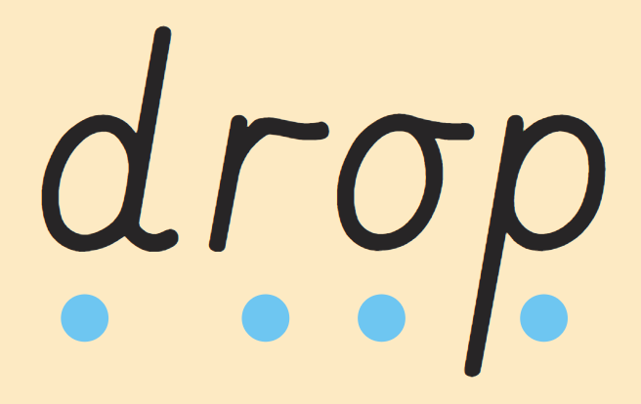
Phase 4

Slide 8
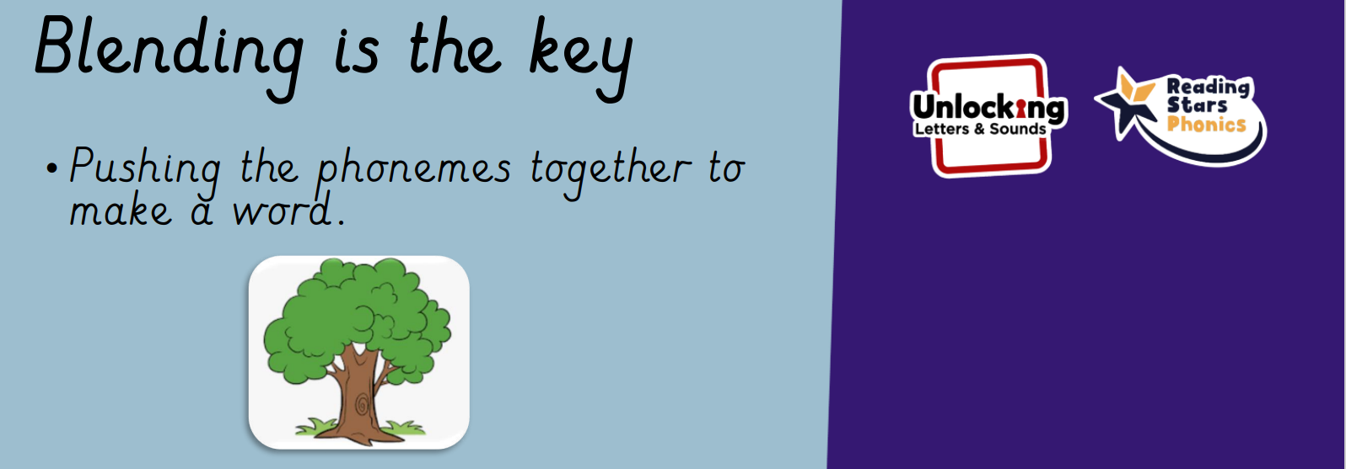
t-o-p top
t-r-ee tree
th-i-ng thing

Slide 9
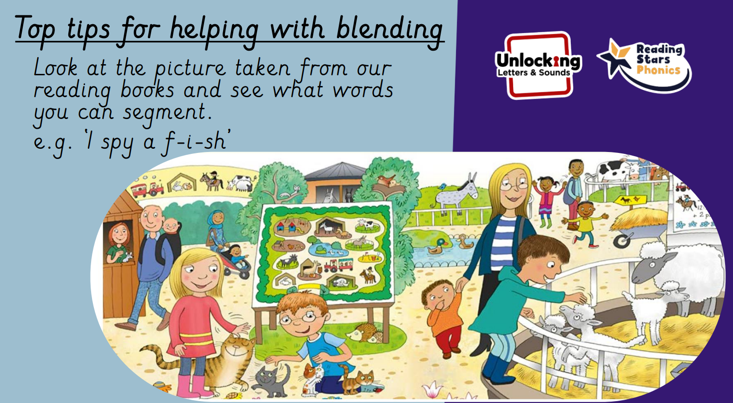

Slide 10
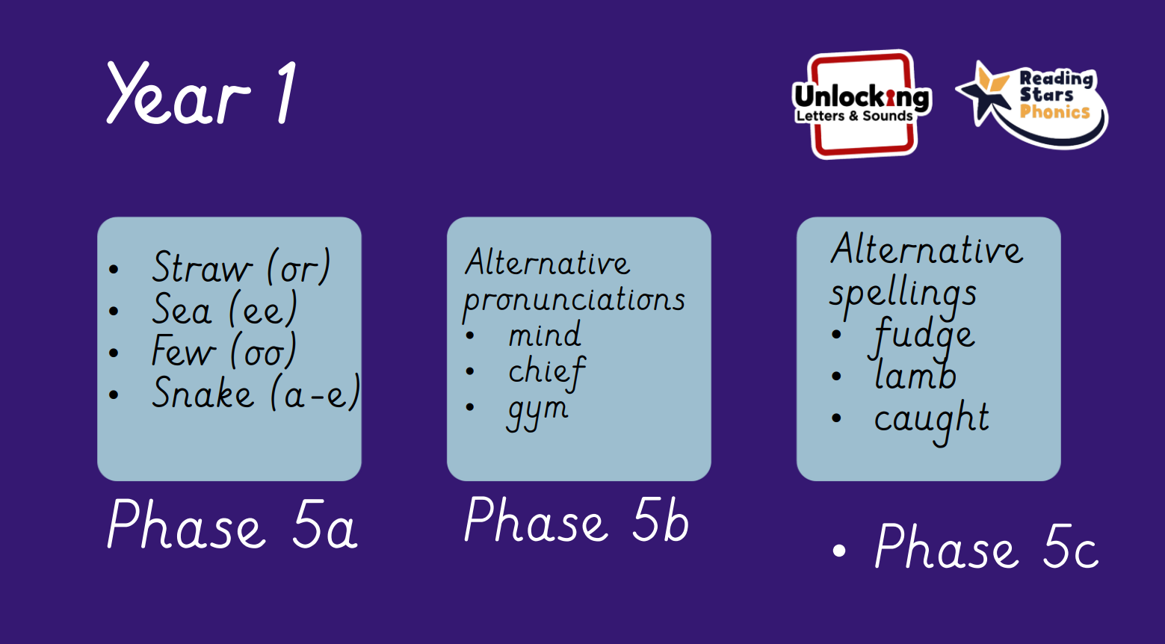

Slide 11
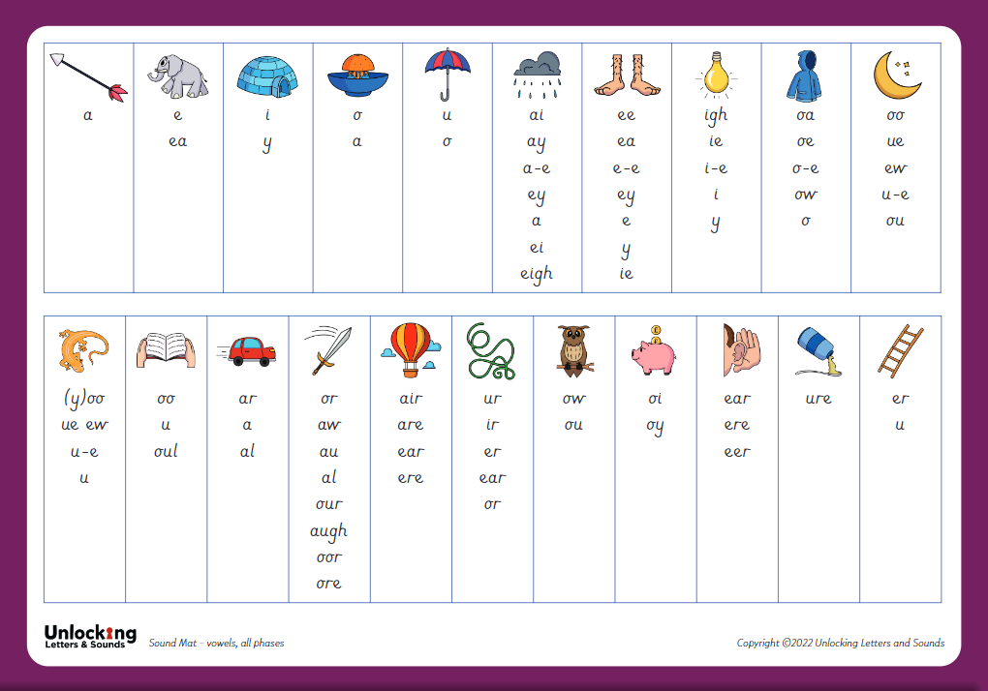
Phase 5

Slide 12
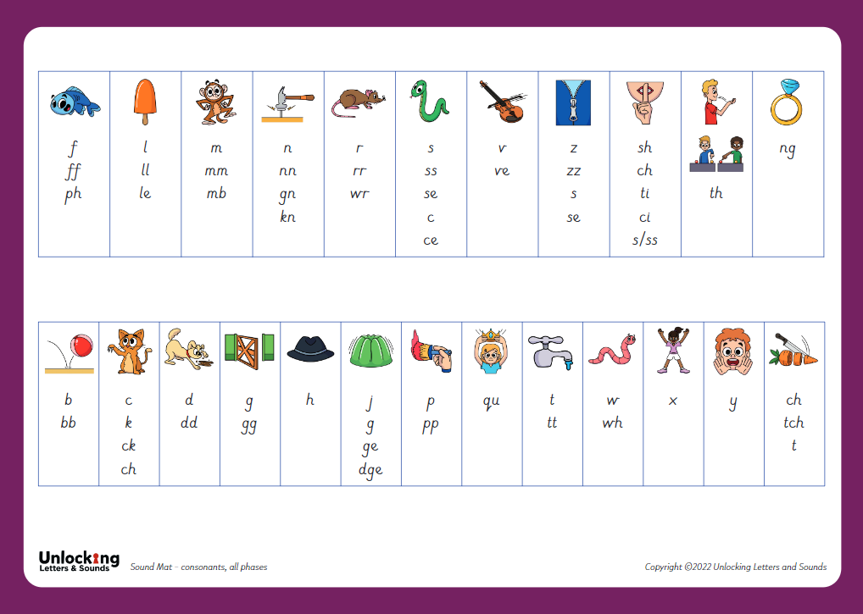
Phase 5

Slide 13
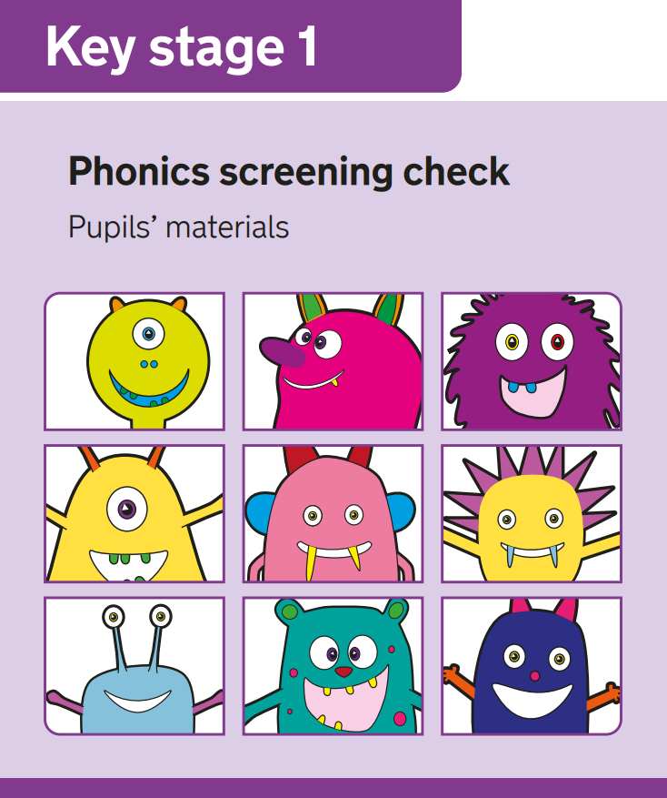
Phonics Screening Check
What is it?
40 words
Real and pseudo (alien)
Allows teachers to assess progress
Results and feedback
Pass mark
Scores will be shared with parents
Re-test in Year 2 if needed

Slide 14
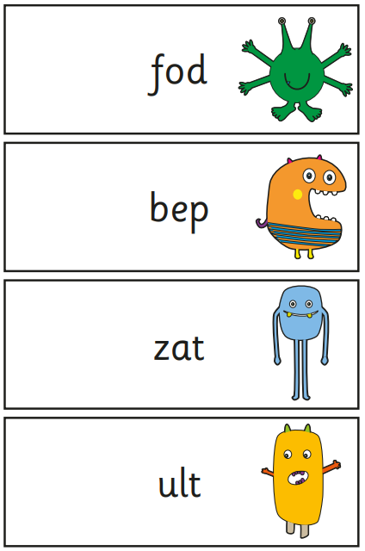
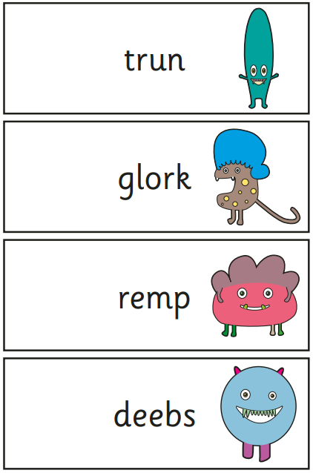
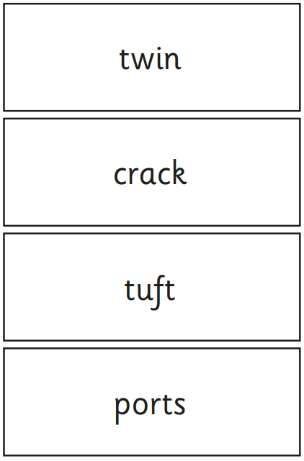
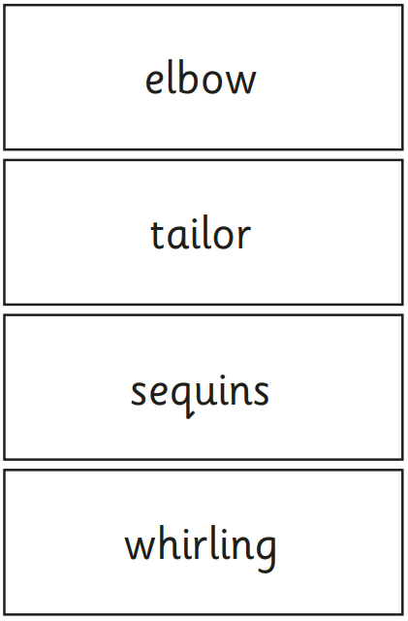
Spot the digraphs- phase 3 and phase 5
Adjacent consonants
Polysyllabic words
Spot the digraphs
Adjacent consonants

Slide 15

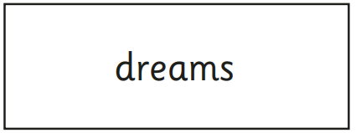
Adding sound buttons

Slide 16


How to help at home
Stick GPCs around the house
Read, read, read!
Child’s decodable book
Being read to
ea
air
Sharing stories to develop vocabulary e.g. saucer, sequins, bowl

Slide 17
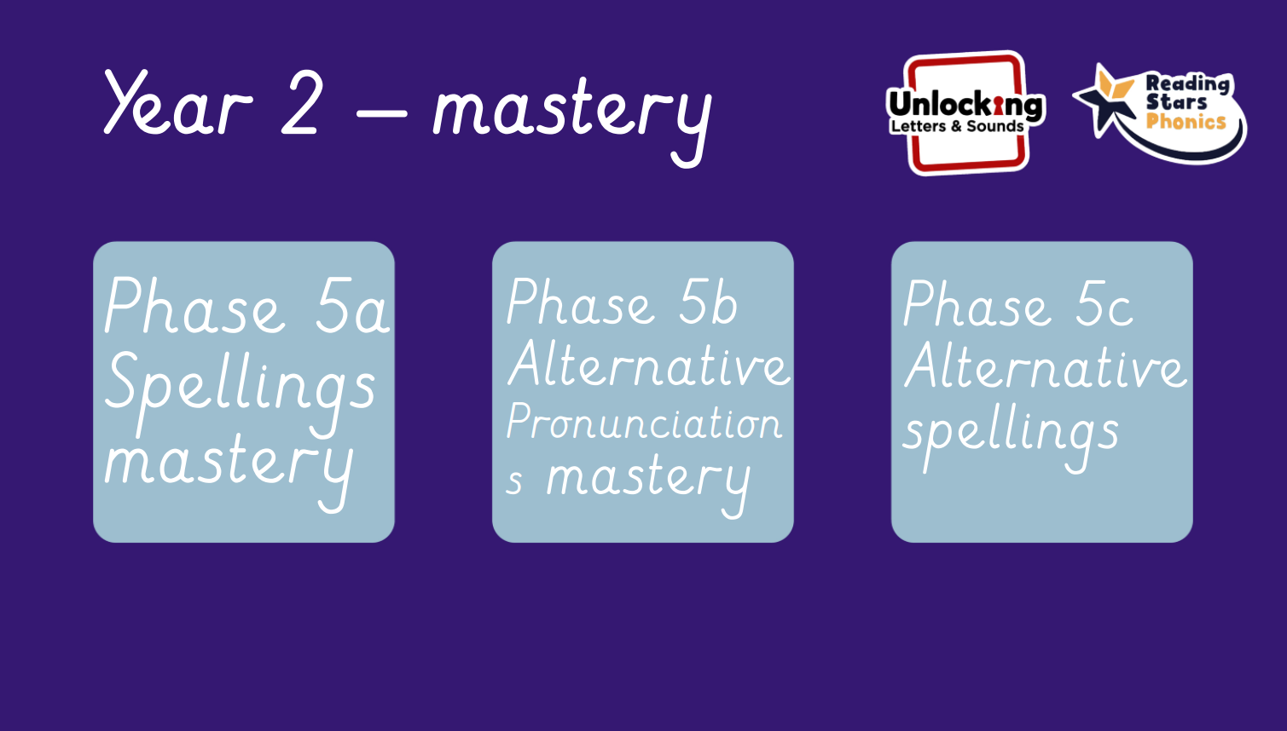

Slide 18
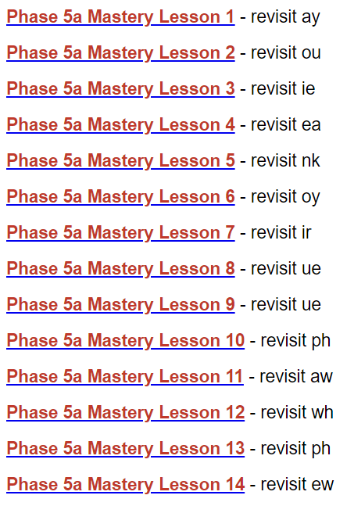
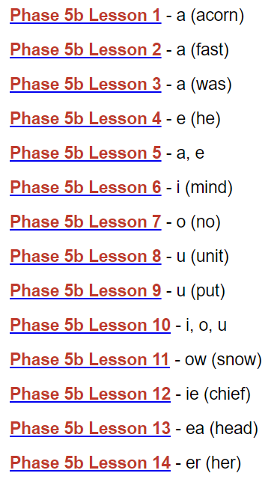
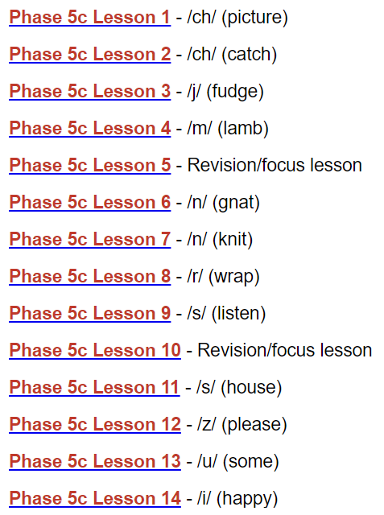
5a mastery spellings recap
5b alternative pronunciations
5c alternative spellings

Slide 19
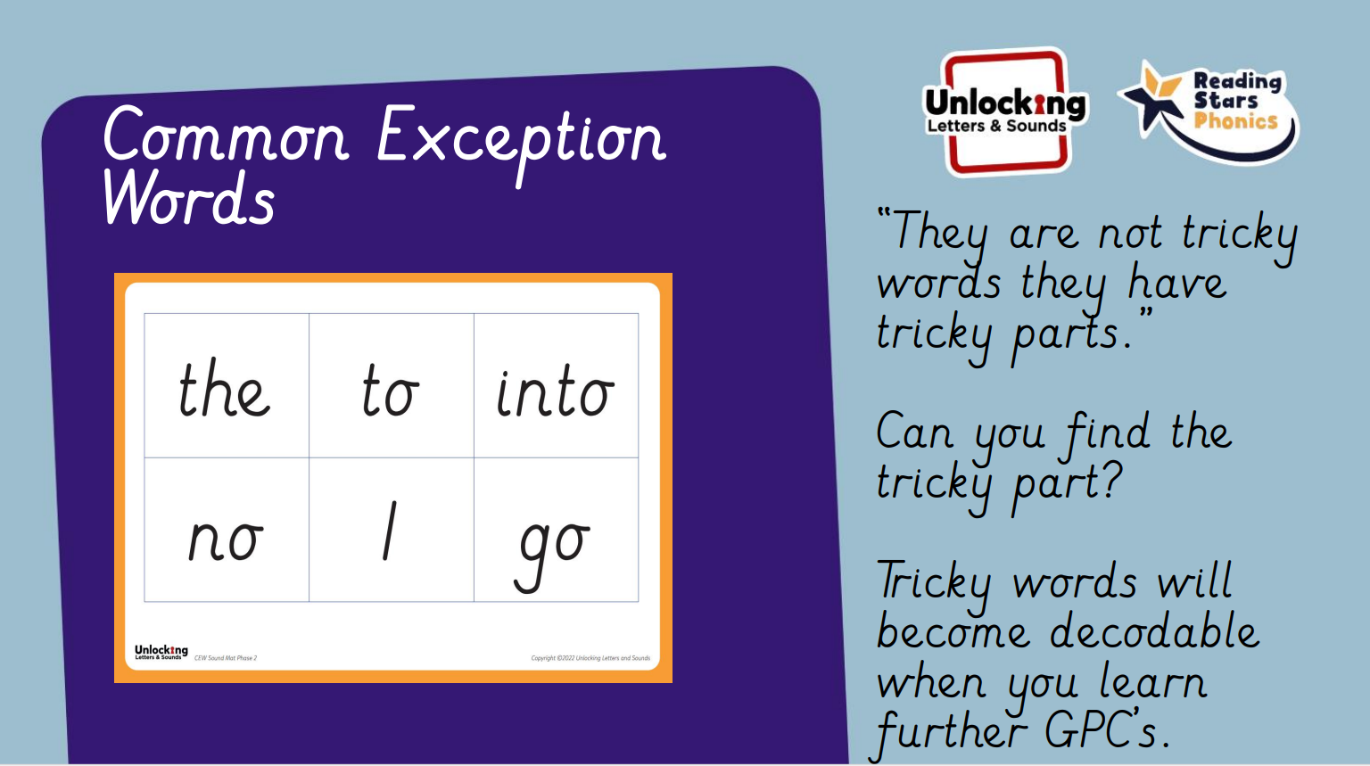

Slide 20
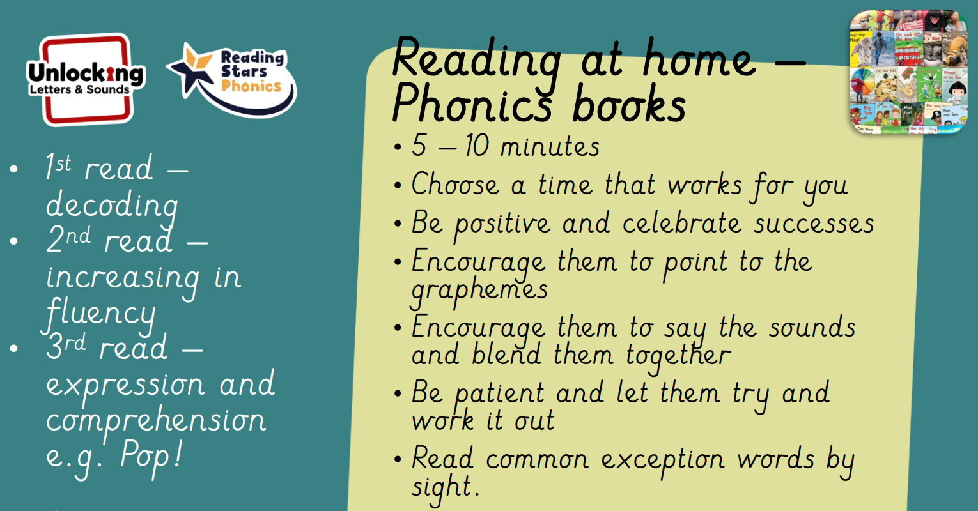

Slide 21
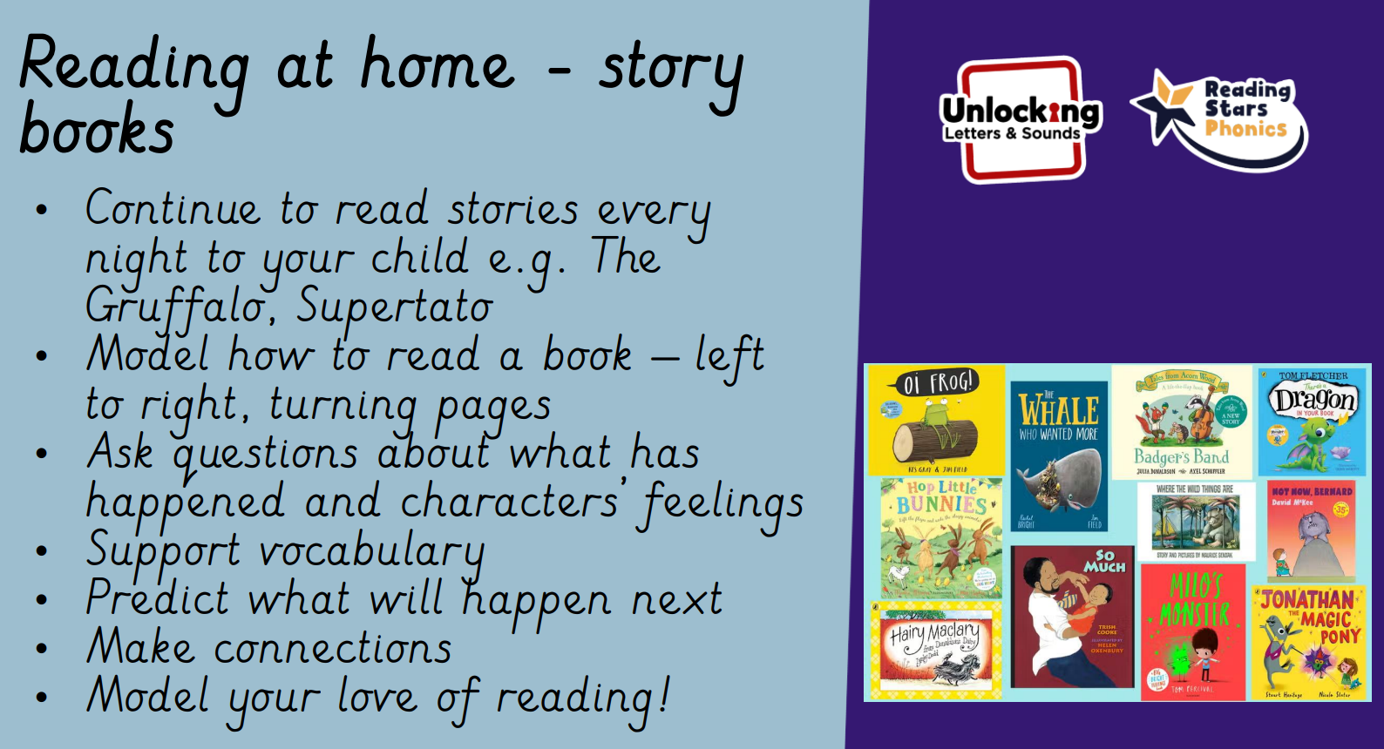

Slide 22
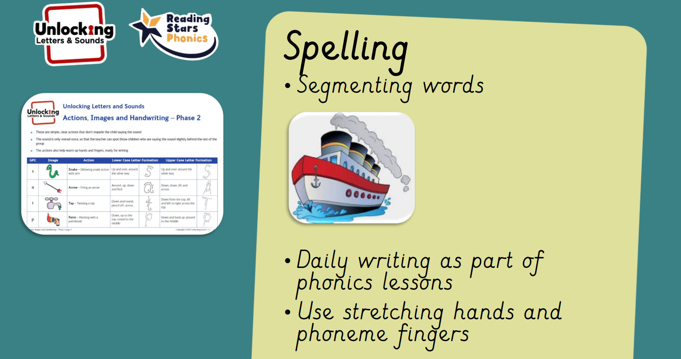

Slide 23
